Slide 1
Applied Data Science Capstone Project
By:
JUAN JUAN
https://github.com/j1-j1/AppliedDataScienceCapstone
January 15, 2024

Slide 2
Outline of the presentation
Executive Summary (Slide 3)
Introduction (Slide 4)
Methodology (Slide 5 to 15)
Results (Slide 16 to 50)
Conclusion (Slide 51)
Acknowledgement (Slide 52)
2

Slide 3
Executive summary
This study collected data from two sources, the SpaceX public API and the SpaceX Wikipedia page. Data wrangling was performed, identifying useful pertinent data. Data analysis was done by using Exploratory Data Analysis (EDA) with data visualization and SQL and further interactive visual analysis was done by using Folium and Plotly Dash.
Predictive analysis was done using Logistic Regression, Support Vector Machine, Decision Tree Classifier, and K Nearest Neighbors and the results obtained were of accuracy rate of 83.33%. The models concluded the prediction of successful landings but more data would produce better accuracy in the future.
3

Slide 4
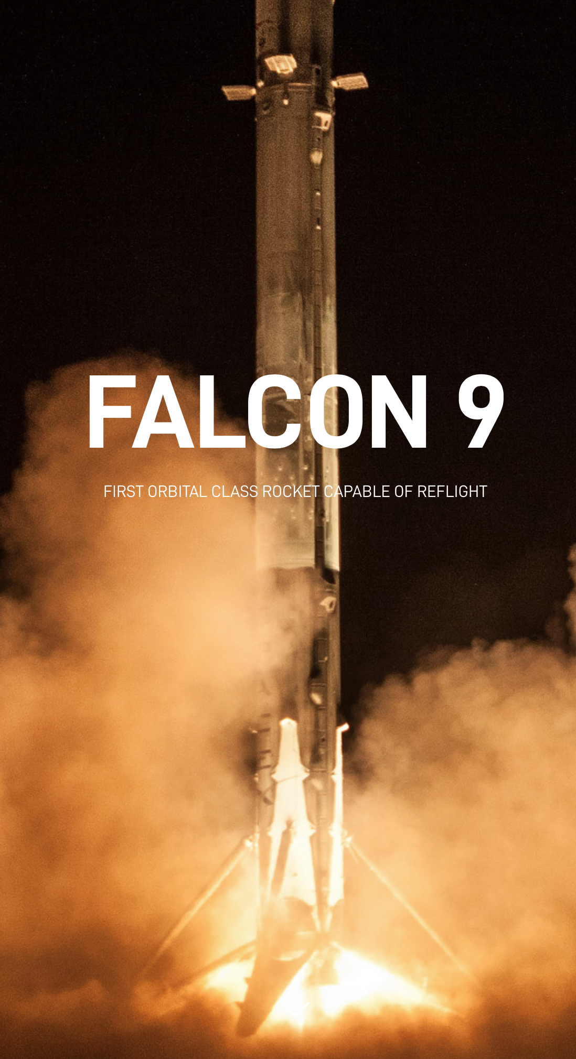
introduction
Background:
Space... The final frontier.
As the commercial space flight becomes more and more viable due to the ability of SpaceX to recover parts of the rocket after launch, bringing cost down.
The Problem:
New emerging contender, SpaceY wants to enter the ring of space flight and this study was done to create a machine learning model to predict the successful Stage1 recovery.
4
Image from SpaceX.com

Slide 5
Methodology
or how was it done?
5

Slide 6
METHODOLOGY
Data Collection
SpaceX API data collection and web scraping
Data Wrangling
Converting collected raw data into usable form
Data Analysis
EDA and interactive visual analytics
Predictive Analysis
Model methods used
6

Slide 7
data collection
Overview:
SpaceX API data collection through API requests and web scraping of tabular data in the SpaceX page in Wikipedia.com
SpaceX API Data included:
FlightNumber, Date, BoosterVersion, PayloadMass, Orbit, LaunchSite, Outcome, Flights, GridFins,Reused, Legs, LandingPad, Block, ReusedCount, Serial, Longitude, Latitude
SpaceX API Data included:
Flight No., Launch site, Payload, PayloadMass, Orbit, Customer, Launch outcome, Version Booster, Booster landing, Date, Time
7

Slide 8
data collection
SpaceX API Data Collection Process:
Request data from SpaceX API
to JSON file
(Launch site, Booster ver., Payload)
put into dictionary required data
from JSON normalized data
replace missing values in PayLoadMass with computed mean
select only Falcon9 launches by filtering data
from dictionary put into DataFrame
export data to a csv file
link:
https://github.com/j1-j1/AppliedDataScienceCapstone/blob/main/
jupyter-labs-spacex-data-collection-api.ipynb
8

Slide 9
data collection
Webscraping from data in Wikipedia:
Request data from Wiki page URL
create BeautifulSoup object from data
parsing HTML Table
extract column/ variable names from HTML header
export data to a csv file
create DataFrame from the dictionary
from parsed records put into dictionary
link:
https://github.com/j1-j1/AppliedDataScienceCapstone/blob/main/
jupyter-labs-webscraping.ipynb
9

Slide 10
data WRANGLING
Conversion of outcomes into Training Labels wherein the value is 0 if first state did not land successfully and value of 1 if it landed successfully.
From the dataset collected, the number of launches on each site was calculated. As each launch aims to a dedicated orbit, the number and occurrence of each orbit was calculated.
The number and occurrence of mission outcomes of the orbits was calculated with ‘True Ocean’ means successfully landed to a specific part of the ocean and ‘False Ocean’ to unsuccessful. Other outcomes include True RTLS, False RTLS, True ASDS, False ASDS, None ASDS and None None, the latter representing failure to land.
link:
https://github.com/j1-j1/AppliedDataScienceCapstone/blob/main/
labs-jupyter-spacex-Data%20wrangling.ipynb
10

Slide 11
eda with data visualization
Exploratory Data Analysis was done through data visualization in order to illustrate the prediction if the Falcon 9 first stage will land successfully. Variables that are included are the Flight Number, Payload Mass, Launch Site, Orbit, Class and the Year.
Visual plots (i.e. Scatterplots, Line Charts, and Bar plots) were done on Flight Number vs. Payload Mass, Flight Number vs. Launch Site, Payload Mass vs. Launch Site, Orbit vs. Success Rate, Flight Number vs. Orbit, Payload vs. Orbit, and the Success Yearly Trend. These data visualizations compare the relationships and trend between the variable and is useful in the machine learning training model.
link:
https://github.com/j1-j1/AppliedDataScienceCapstone/blob/main/
jupyter-labs-eda-dataviz.ipynb.jupyterlite.ipynb
11

Slide 12
eda with SQL
Loading the SpaceX dataset (which includes the record for each payload carried during the SpaceX mission into space), in order to query useful tables of information for the Exploratory Data Analysis.
To aid in the data analysis, SQL queries were made to show information that are needed and show trends and relationships between the variables in the dataset.
The information obtained through SQL queries include Launch Sites, Mission Outcomes, Payload Mass, Booster versions and Landing Outcomes.
link:
https://github.com/j1-j1/AppliedDataScienceCapstone/blob/main/
jupyter-labs-eda-sql-coursera_sqllite.ipynb
12

Slide 13
interactive visual map with folium
Location, location, location. The success rate of a launch would depend on factors like payload mass, orbit type among others. But the location and proximities of the launch site is also critical to success.
Using Folium, interactive maps were created to visualize the SpaceX dataset in aid of finding an optimal location for the launch site which involves various factors. These include proximity to various key locations like Railways, Highways, Coastal Area, and Cities.
This interactive maps helps to visualize successful landings in relation to launch site location.
link:
https://github.com/j1-j1/AppliedDataScienceCapstone/blob/main/
lab_jupyter_launch_site_location.jupyterlite.ipynb
13

Slide 14
dashboard with plotly dash
A web-based Plotly Dash Application was done to perform interactive visual data analysis using the SpaceX launch dataset. The Plotly Dash application contains interactive elements like a dropdown menu list and a range slider in order to visualize in real-time data in the form of a pie chart and a scatter point chart.
The Pie chart visualizes the distribution of successful landings across the launch site wherein individual launch site success rates could be selected.
The Scatterplot visualizes the relationship of Launch Sites, Payload Mass and Booster version in relation to success.
link:
https://github.com/j1-j1/AppliedDataScienceCapstone/blob/main/
spacex_dash_app.py
14

Slide 15
Machine learning Prediction analysis
EDA process and determining Training Labels:
Load DataFrame from csv file
create Numpy array from Class in data
Split data to Training and Test Datasets
Standardize data and transform using StandardScaler
Calculate the accuracy on the test data, Confusion Matrix for all models
GridSearchCV to find best parameters form dictionary
Assign labels to the split dataset
Create Barplot to compare scores from models
link:
https://github.com/j1-j1/AppliedDataScienceCapstone/blob/main/
SpaceX_Machine_Learning_Prediction_Part_5.jupyterlite.ipynb
15

Slide 16
Results
EDA With Visualization Results
EDA With SQL Results
Interactive Map With Folium Results
Plotly Dash Dashboard Results
Predictive Analysis Results
16

Slide 17
EDA with visualization results
Flight Number Vs. PayLoad Mass (Slide 18)
Flight Number Vs. Launch Site (Slide 19)
PayLoad Mass Vs. Launch Site (Slide 20)
Success Rate Vs. Orbit Type (Slide 21)
Flight Number Vs. Orbit Type (Slide 22)
PayLoad Mass Vs. Orbit Type (Slide 23)
Success Rate Vs. Year (Slide 24)
link:
https://github.com/j1-j1/AppliedDataScienceCapstone/blob/main/
jupyter-labs-eda-dataviz.ipynb.jupyterlite.ipynb
17

Slide 18
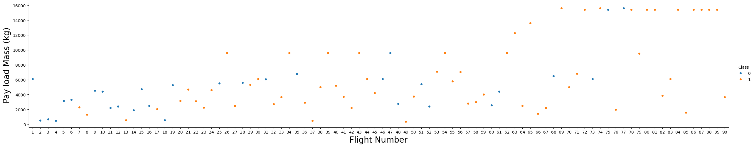
EDA with visualization results
Flight Number Vs. PayLoad Mass
The different success rates of the different launch sites seen in this visualizing detailed launch records, namely of CCAFS LC-40 with 60% rate, KSC LC-39A and VAFB SLC 4E with 77% success rate. Results point that the bigger the payload, the less likely of successful first state return.
18

Slide 19
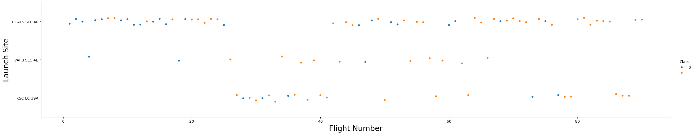
EDA with visualization results
Flight Number Vs. Launch Site
As illustrated above, with the orange dots indicating success of launch and blue as failed launch, launch site CCAFS SLC 40, has significantly more flights and successful launches compared to VAFB SLC 4E and KSC LC 39A, suggesting that it appears to be the main launch site.
19

Slide 20
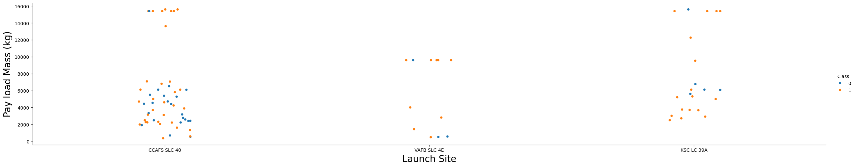
EDA with visualization results
PayLoad Mass Vs. Launch Site
The scatter point chart above suggests that the launch site VAFB SLC 4E, having launched no rockets that has more that 10000kg. Also seen above that different launch sites tend to have different payload mass rocket launches.
20

Slide 21
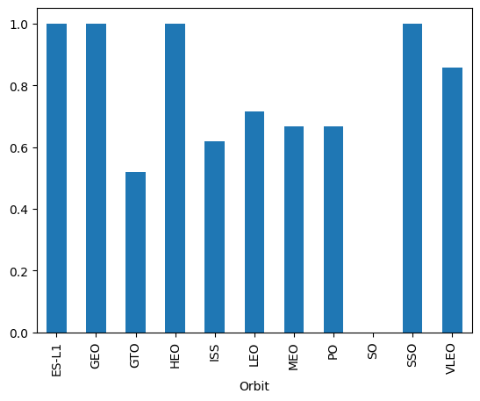
EDA with visualization results
Success Rate Vs. Orbit Type
As seen in the bar graph above, showing success rate of each orbit, orbits ES-L1, GEO, HEO, and SSO has the greatest success rates. Followed by orbit VLEO and then GTO. Also seen is that orbit SO has zero success rate.
21

Slide 22
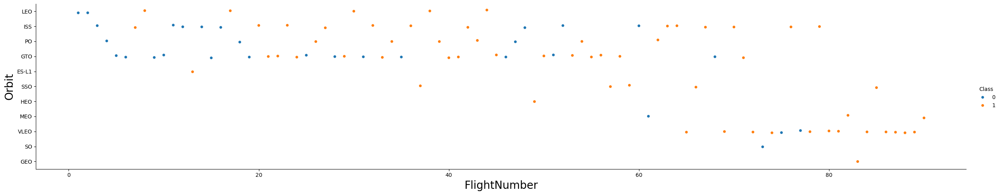
EDA with visualization results
Flight Number Vs. Orbit Type
As seen in the scatter plot chart above, there is a preference change from the flight number and inferred is that relationship of successful outcome, shown as orange dots. VLEO orbits were recent and have moderately successful outcomes. The Leo orbit has the success related to the number of flights.
22

Slide 23
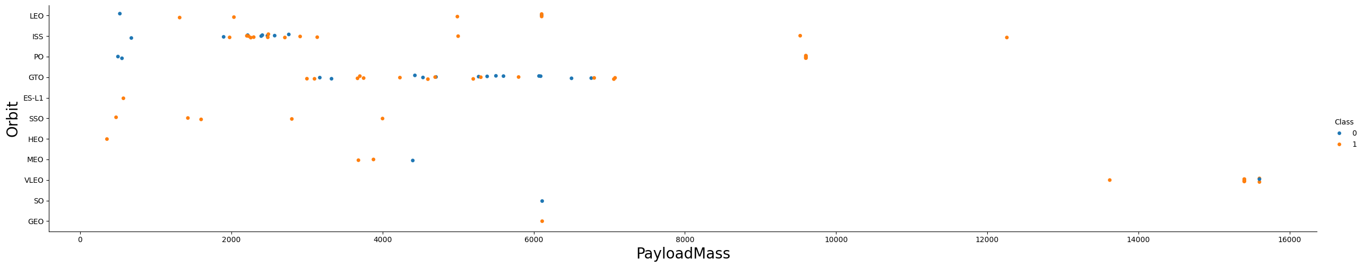
EDA with visualization results
PayLoad Mass Vs. Orbit Type
As seen in the scatter plot above, there are more successful landings for PO, LEO and ISS, suggesting a positive relationship with payloads. Also seen is that in GTO orbit, there seems to be no positive or negative relationship on payload mass to the success rate.
23

Slide 24
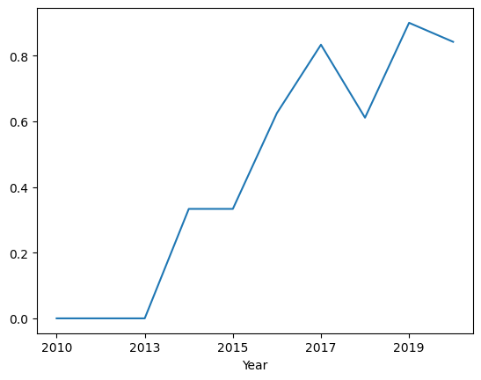
EDA with visualization results
Success Rate Vs. Year
As seen in the graph above, there is an upward trend in the success rate per year starting from 2010 up to 2020. The most recent year in the graph, 2020 is shown with 80 percent success rate.
24

Slide 25
EDA with SQL results
Unique Launch Sites (Slide 26)
Launch Sites that begin with ‘CCA’ (Slide 27)
Total PayLoad Mass by NASA (CRS) (Slide 28)
Average PayLoad Mass by F9 v1.1 (Slide 29)
Dates First Successful Outcome (Slide 30)
Names Successful Between 4000 and 6000 (Slide 31)
Success and Failure Mission Outcomes (Slide 32)
Booster Version with Max PayLoad (Slide 33)
Failed Landing Outcome in 2015 (Slide 34)
Landing Outcomes 2010-06-04 to 2017-03-20 (Slide 35)
link:
https://github.com/j1-j1/AppliedDataScienceCapstone/blob/main/
jupyter-labs-eda-sql-coursera_sqllite.ipynb
25

Slide 26
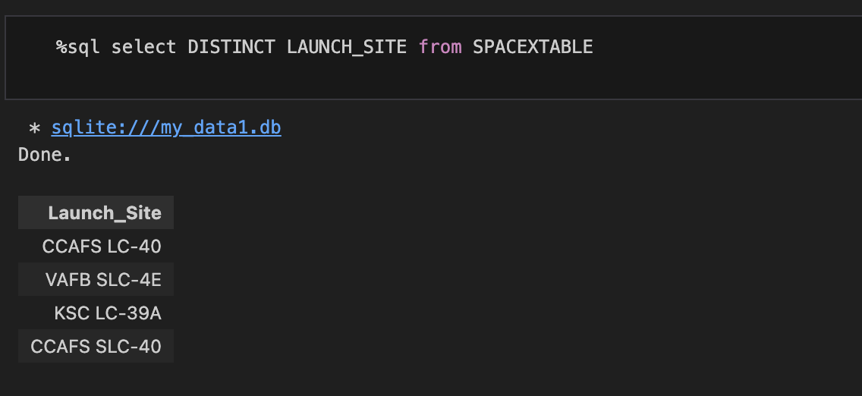
EDA with sql results
Unique Launch Sites
The SQL Query shown above would produce results that show the unique launch sites. The launch sites are CCAFS LC-40, VAFB SLC-4E, KSC LC-39A and CCAFS SLC-40.
26

Slide 27
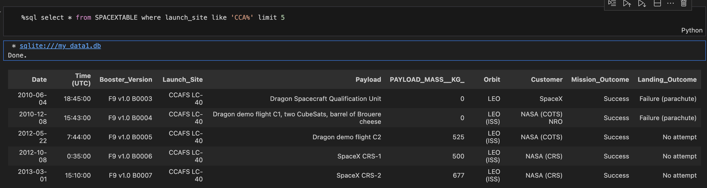
EDA with sql results
Launch Sites that begin with ‘CCA’
The SQL Query shown above selects from the SpaceX dataset, the results wherein launch sites begin with CCA limiting to 5 entries.
27

Slide 28
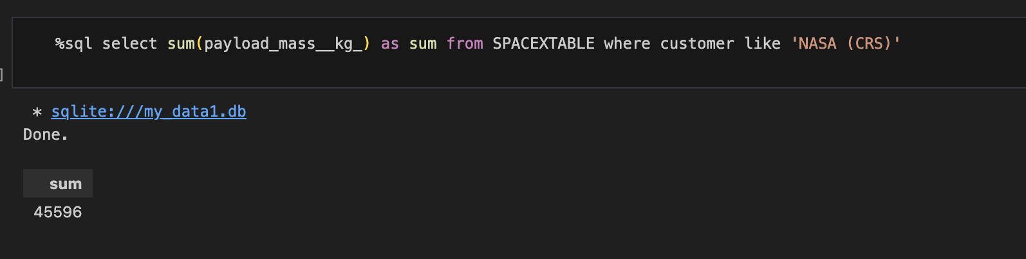
EDA with sql results
Total PayLoad Mass by NASA (CRS)
The SQL Query shown above shows the total payload mass in kg of NASA and the CRS or Commercial Resupply Services means that the payloads were director to the International Space Station.
28

Slide 29
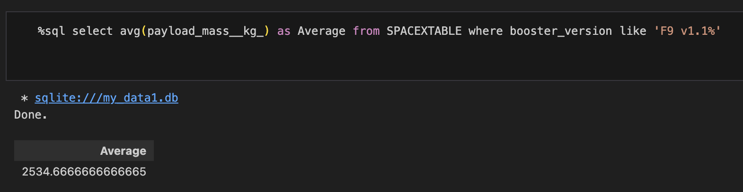
EDA with sql results
Average PayLoad Mass by F9 v1.1
The SQL Query shown above shows the average payload mass in kg of booster version F9 v1.1 which is 2534.66.
29

Slide 30
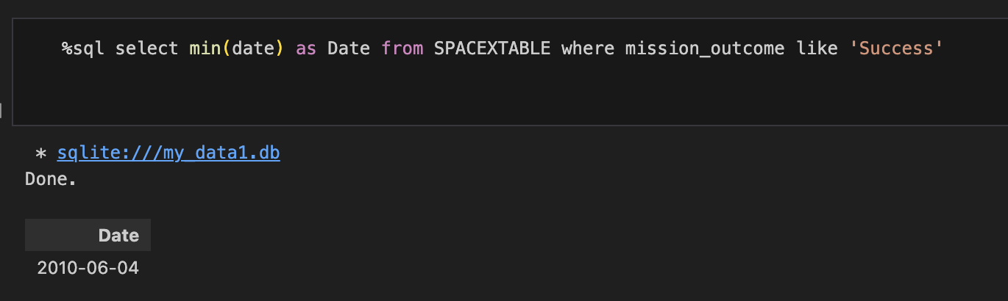
EDA with sql results
Dates First Successful Outcome
The SQL Query shown above shows the date of the first successful outcome which is on June 4, 2010.
30

Slide 31
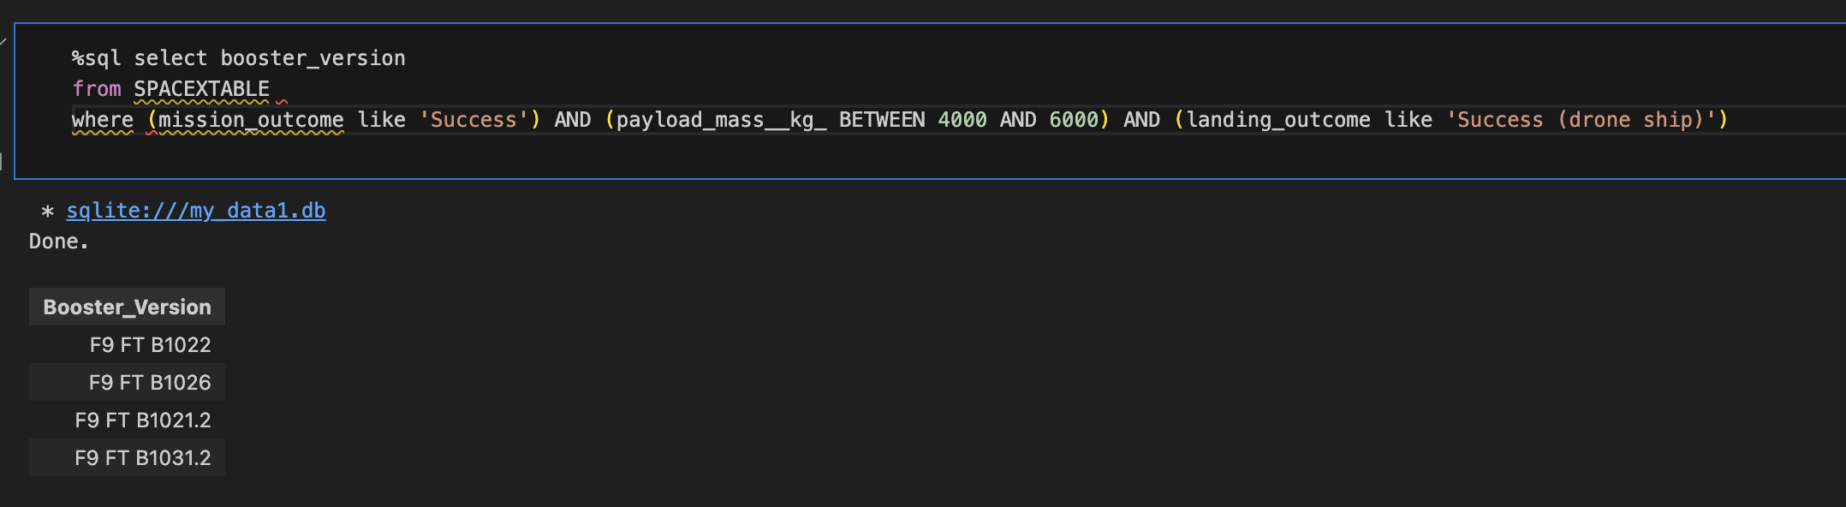
EDA with sql results
Names Successful Between 4000 and 6000
The SQL Query shown above shows the booster versions where the outcome is successful and the payload mass is between 4000kg and 6000kg. As seen, there are four results, F9 FT B1022, F9 FT B1026, F9 FT B1021.2 and F9 FT B1031.2.
31

Slide 32
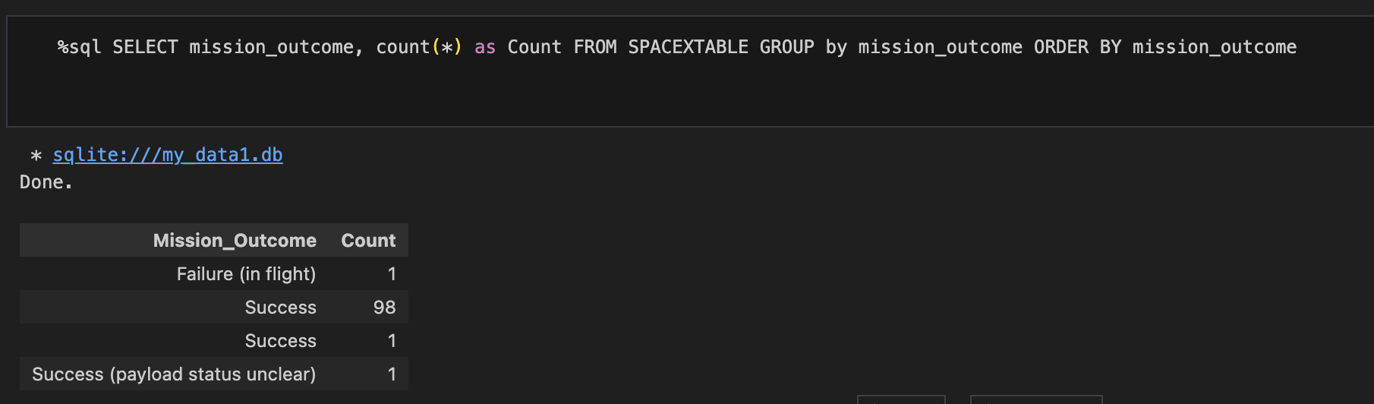
EDA with sql results
Success and Failure Mission Outcomes
The SQL Query shown above returns the count of each mission outcome and further illustrates a 99 percent mission outcome and 1 percent failure in flight was observed.
32

Slide 33
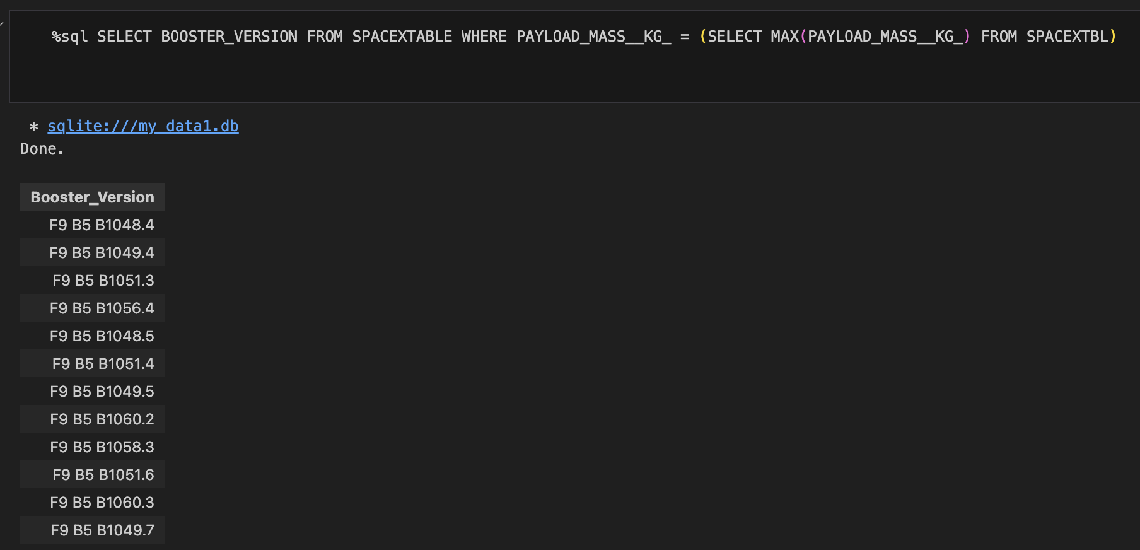
EDA with sql results
Booster Version with Max PayLoad
The SQL Query shown above returns the booster versions which have carried the maximum payload mass, and as shown the versions are similar, indicating a relationship of booster version used to the payload mass.
33

Slide 34
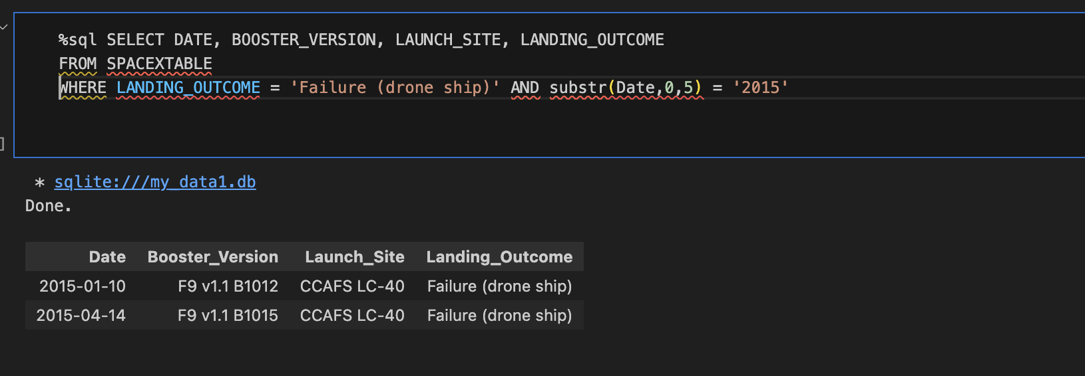
EDA with sql results
Failed Landing Outcome in 2015
The SQL Query shown above returns the failed landing outcome that was on the year 2015 and as illustrated by the result that there are two failures, one in January 2015 and the other one is in April 2015.
34

Slide 35
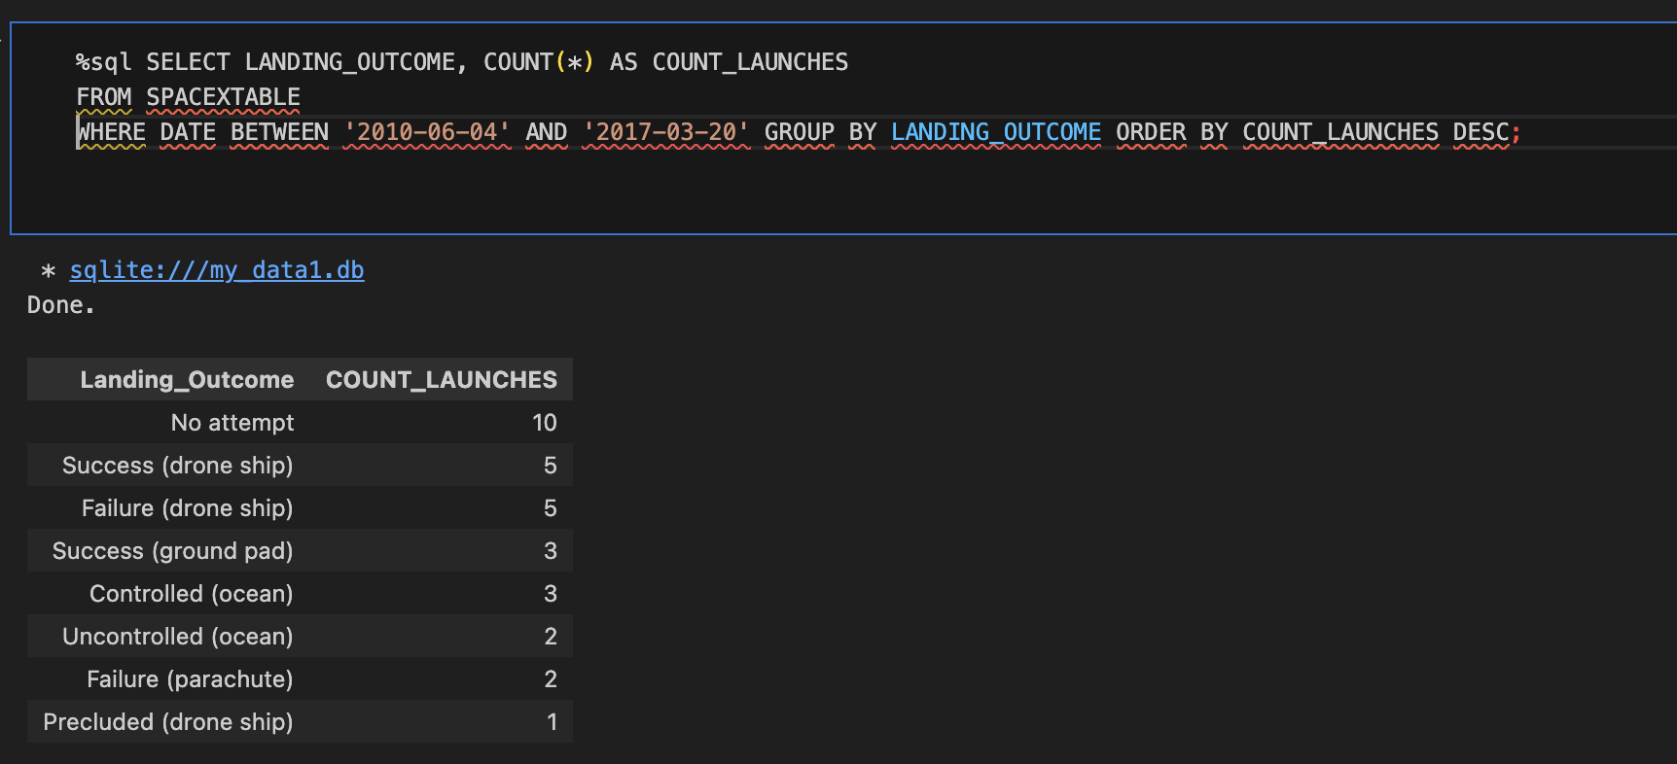
EDA with sql results
Landing Outcomes 2010-06-04 to 2017-03-20
The SQL Query shown above returns the count of the landing outcomes (drone ship, ground pad, ocean, parachute and no attempt) between the date of June 4, 2010, and March 3, 2017.
35

Slide 36
INTERACTIVE MAP WITH FOLIUM RESULTS
Launch Site Locations (Slide 37)
Success and Fail Markers (Slide 38)
Proximity of Key Locations (Slide 39)
link:
https://github.com/j1-j1/AppliedDataScienceCapstone/blob/main/
lab_jupyter_launch_site_location.jupyterlite.ipynb
36

Slide 37
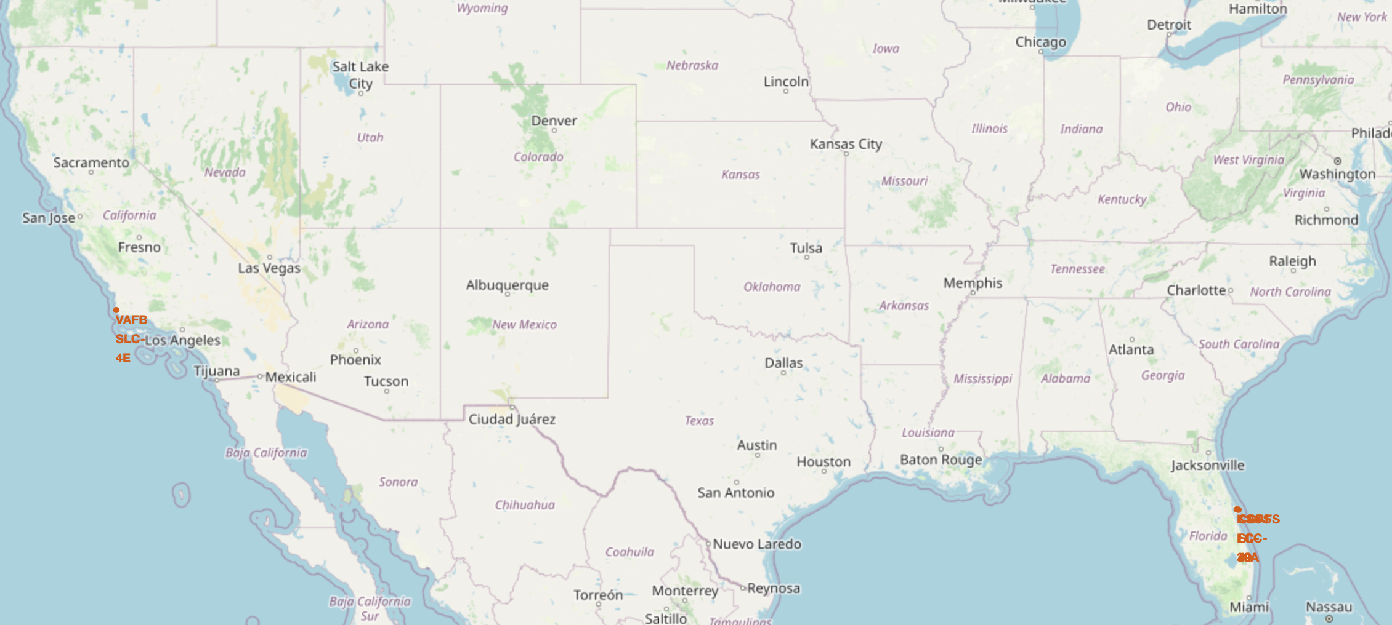
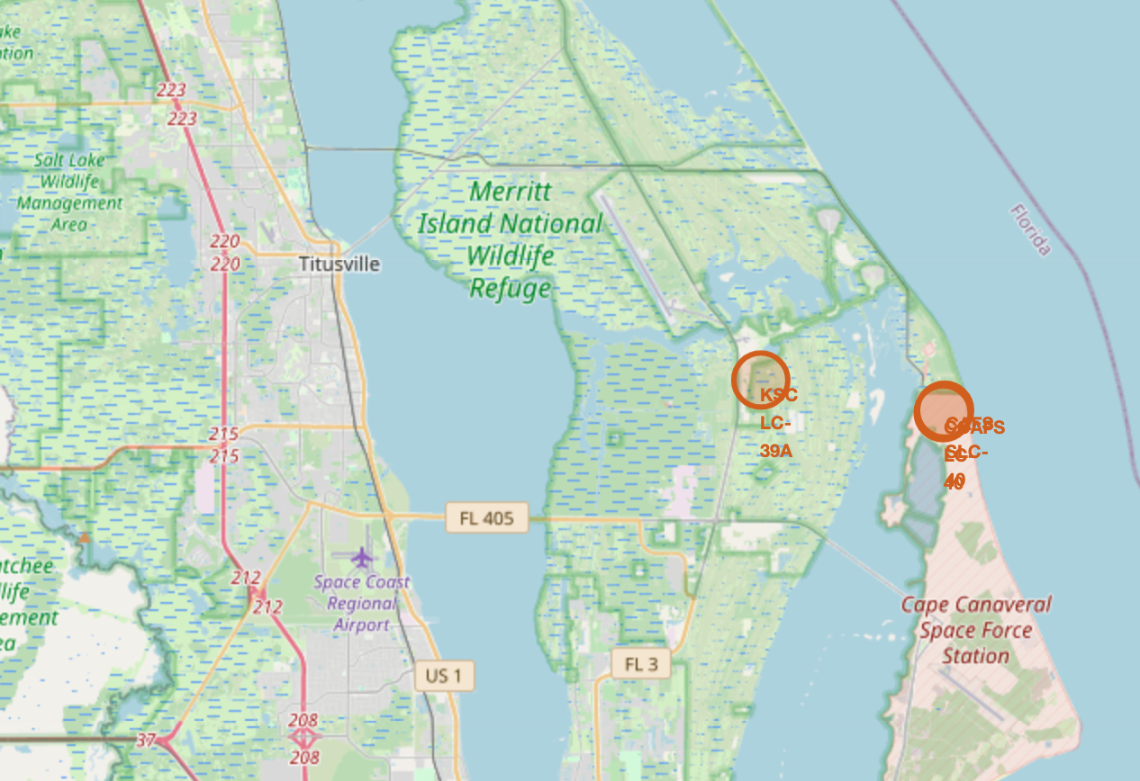
INTERACTIVE MAP WITH FOLIUM RESULTS
Launch Site Locations
The image above shows a screenshot of the interactive map showing the location of the launch sites in the United States. The right part of the map shows that there are two launch sites located near each other in Florida and all launch sites are located near the ocean.
37

Slide 38
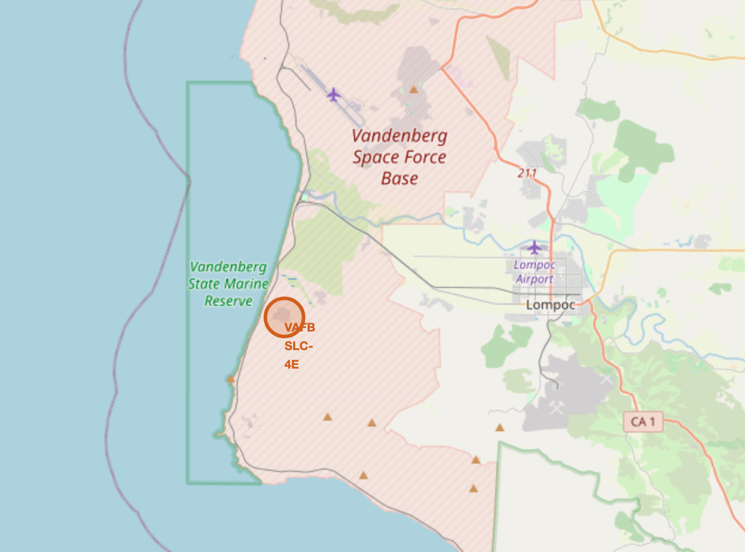
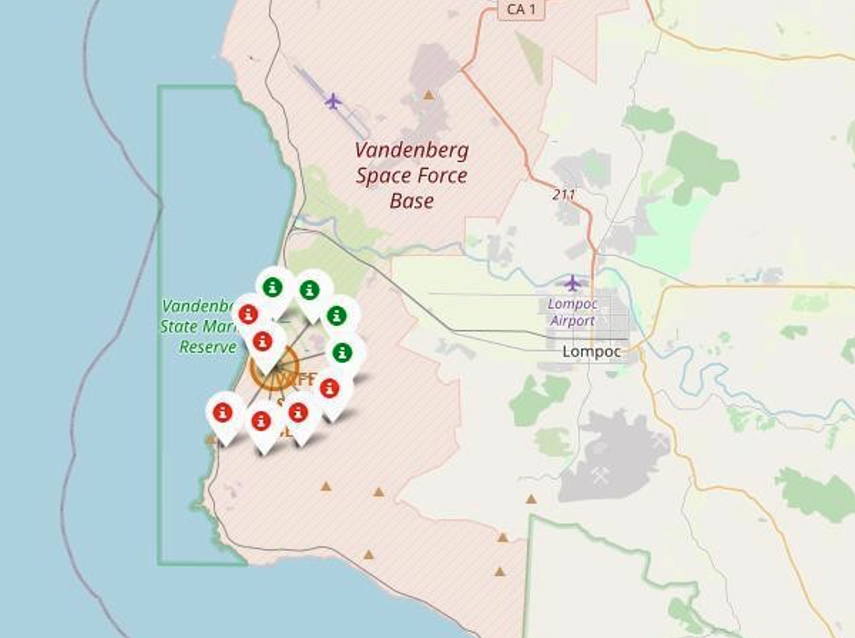
INTERACTIVE MAP WITH FOLIUM RESULTS
Success and Fail Markers
The image above is a screenshot of the interactive map showing the clusters when clicked (right image), wherein the green icons show successful landing and the red icons shows the failed landings.
38

Slide 39
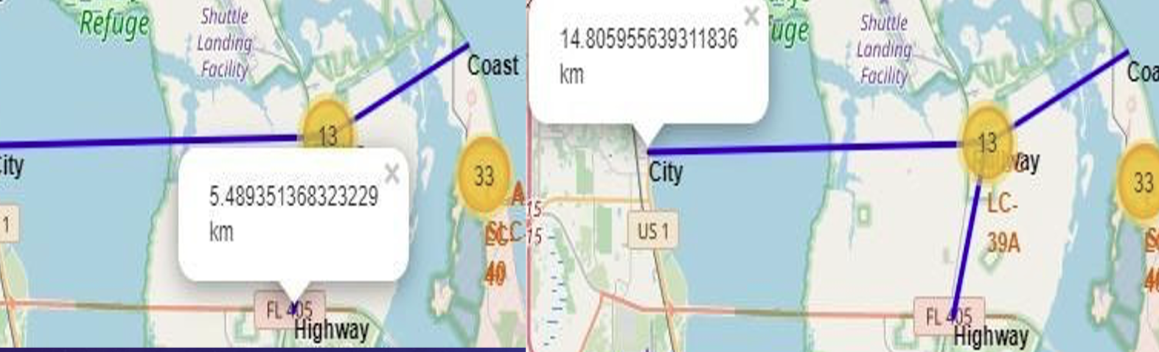
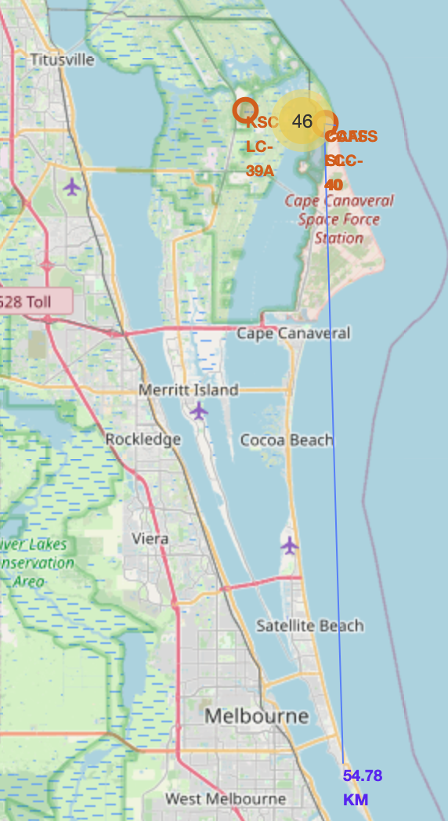
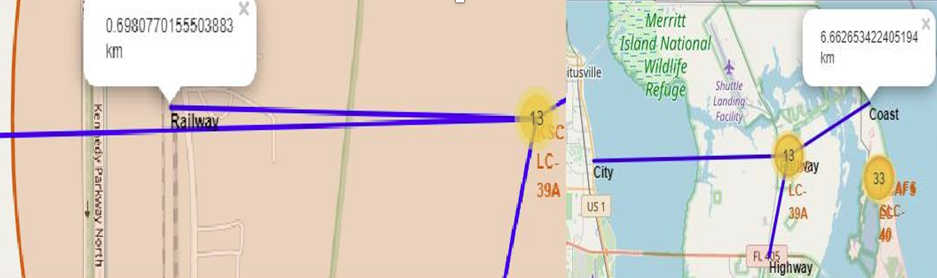
INTERACTIVE MAP WITH FOLIUM RESULTS
Proximity of Key Locations
The image above are screenshots of the interactive map which shows the launch sites and the proximity or the nearness of these launch sites to key locations, including highways, railways, and cities. As show the location of the launch sites are relatively far from densely populated cities in case of launch failure.
39

Slide 40
PLOTLY DASH DASHBOARD RESULTS
SpaceX Launch Plotly Dashboard (Slide 41)
Launch Success by Launch Site (Slide 42)
Most Successful Launch Site (Slide 43)
Payload Mass Vs Success Vs Booster Version (Slide 44)
link:
https://github.com/j1-j1/AppliedDataScienceCapstone/blob/main/
spacex_dash_app.py
40

Slide 41
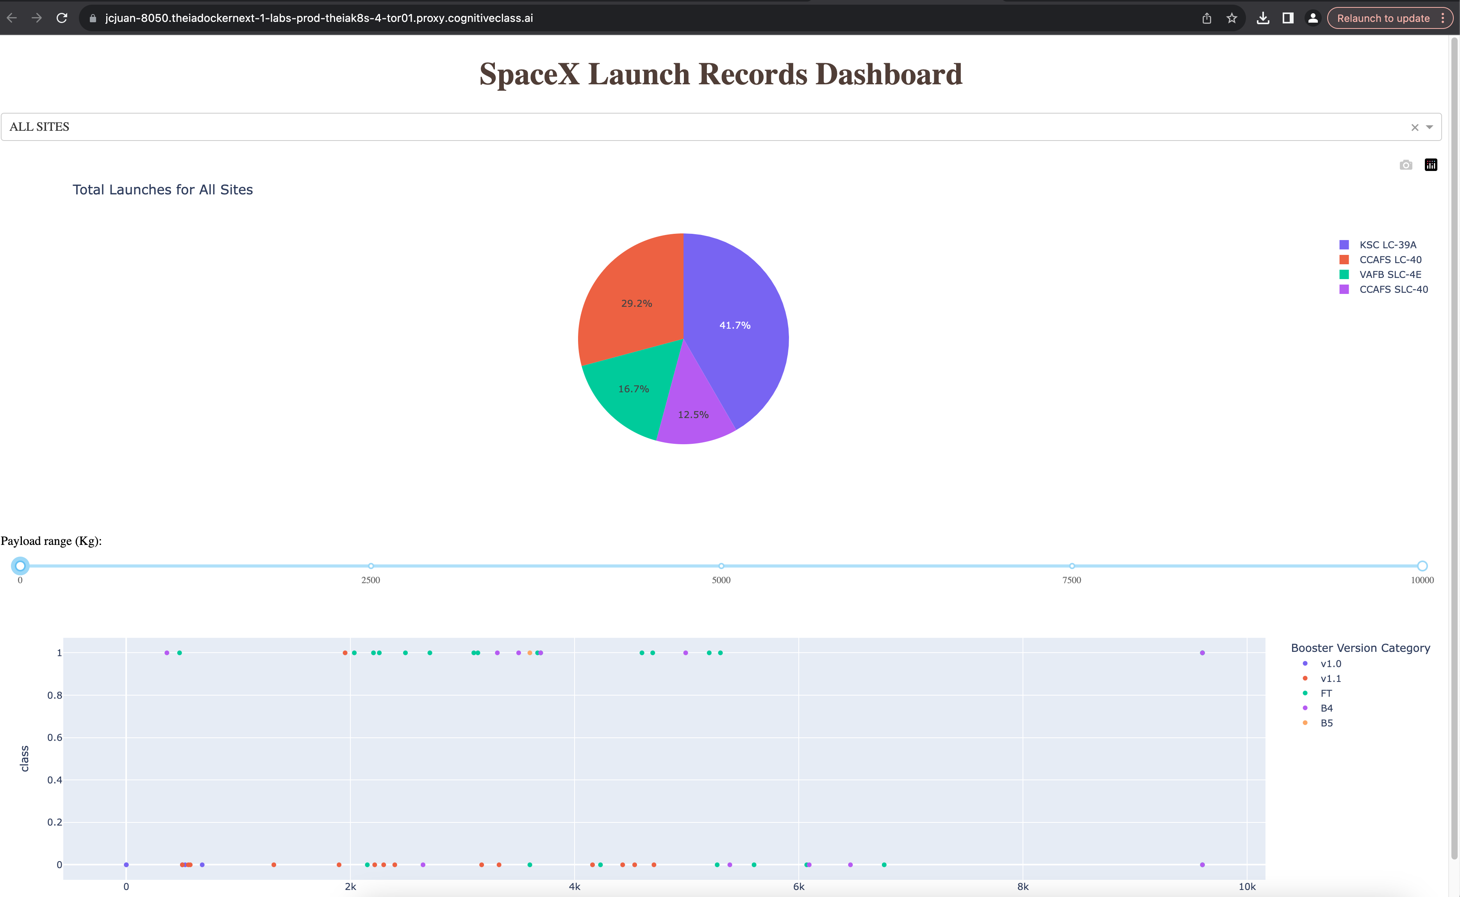
PLOTLY DASH DASHBOARD RESULTS
SpaceX Launch Plotly Dashboard
The image above is a screenshot of the interactive dashboard created showing the SpaceX Launch Records with a dropdown menu showing Pie Chart for launches and a slider to change the range for payload mass.
41

Slide 42
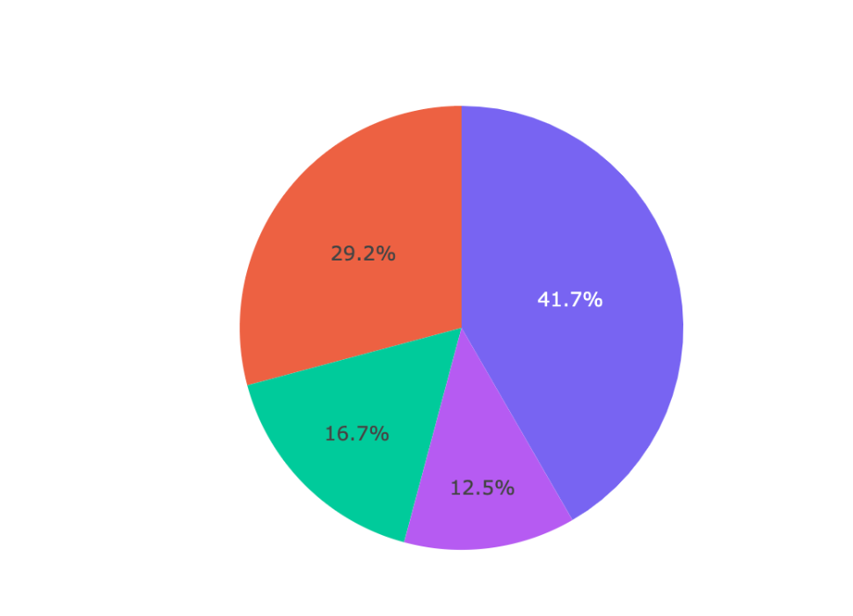
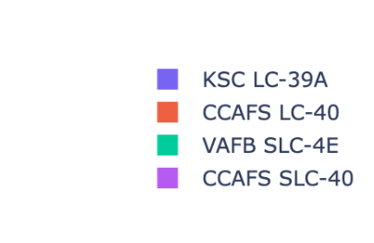

PLOTLY DASH DASHBOARD RESULTS
Launch Success by Launch Site
As shown above from the interactive dashboard, illustrating the percentage share of the successful launches across the launch sites. KSC LC-39A has the majority with 41.7 percent. CCAFS LC-40 is the predecessor of CCAFS SLC-40 and by that the smallest percent of successful landings is the VAFB SLC-4E
42

Slide 43
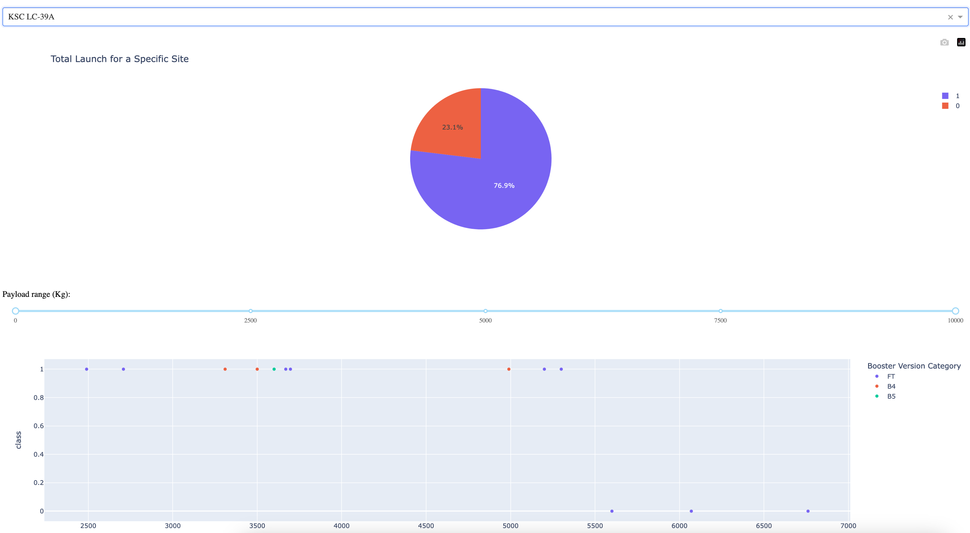
PLOTLY DASH DASHBOARD RESULTS
Most Successful Launch Site
The image above, taken from the interactive dashboard, shows the most successful launch site which is the KSC LC-39A which has roughly 75 percent success rate.
43

Slide 44
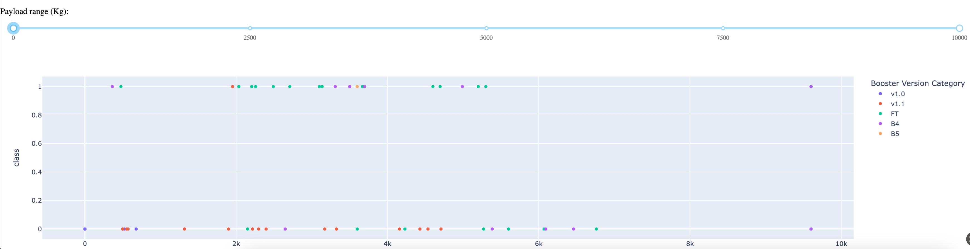
PLOTLY DASH DASHBOARD RESULTS
Payload Mass Vs Success Vs Booster Version
The image above, taken from the interactive dashboard wherein a slider was put on the range of 0 to 6000 kg and the different colored dots indicating the booster versions. Also seen on the scatter plot is the success and failure of each of the booster versions.
44

Slide 45
PREDICTIVE ANALYSIS RESULTS
Logistic Regression (Slide 46)
Support Vector Machine (Slide 47)
Decision Tree Classifier (Slide 48)
K Nearest Neighbors (Slide 49)
Comparison of Models (Slide 50)
link:
https://github.com/j1-j1/AppliedDataScienceCapstone/blob/main/
SpaceX_Machine_Learning_Prediction_Part_5.jupyterlite.ipynb
45

Slide 46
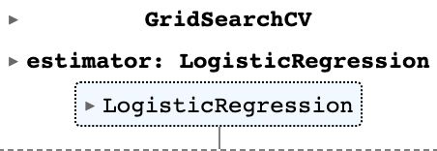
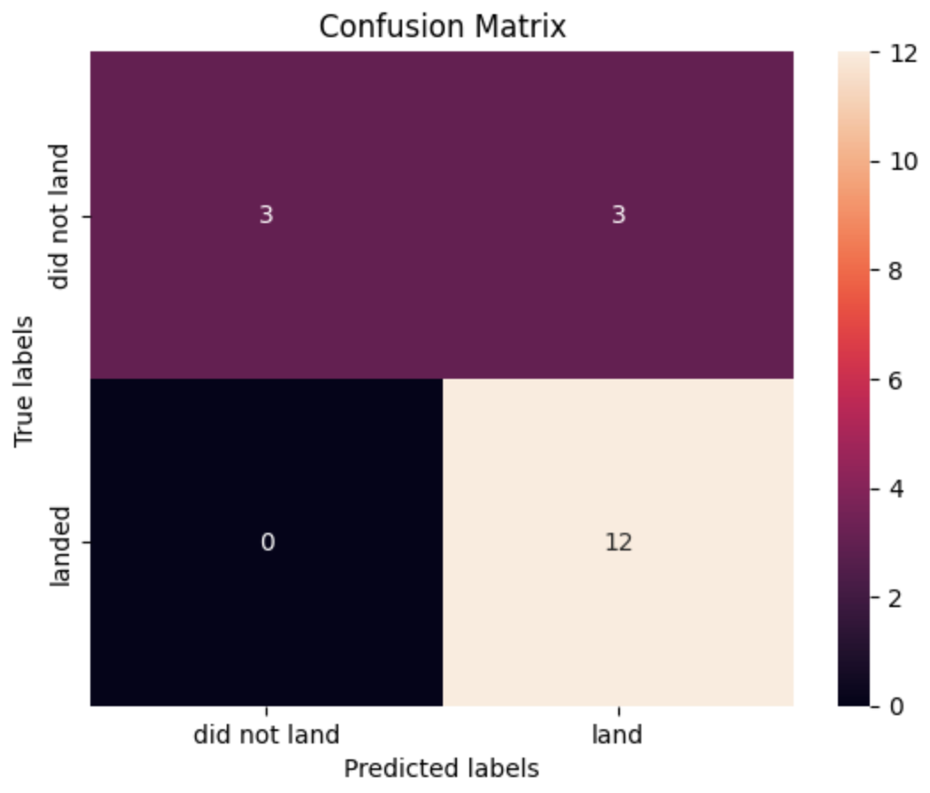
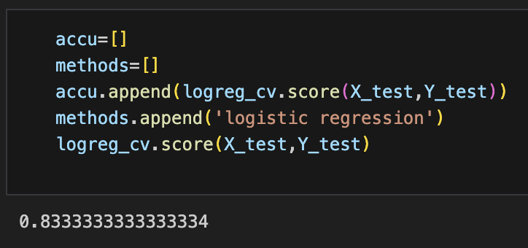
PREDICTIVE ANALYSIS RESULTS
Logistic Regression
The image above shows the GridSearchCV for Logistic Regression and the accuracy on the test data using the method score is 0.83. Also shown is the confusion matrix of the logistic regression model.
46

Slide 47
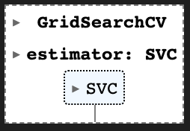

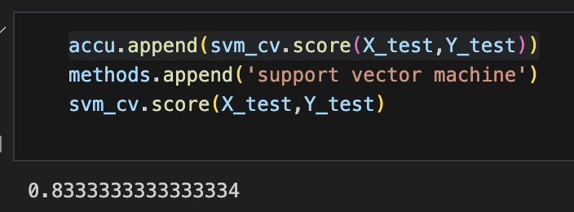
PREDICTIVE ANALYSIS RESULTS
Support Vector Machine
The image above shows the GridSearchCV for Support Vector Machine model and the accuracy on the test data using the method score is also 0.83. Also shown is the confusion matrix of the support vector machine model.
47

Slide 48
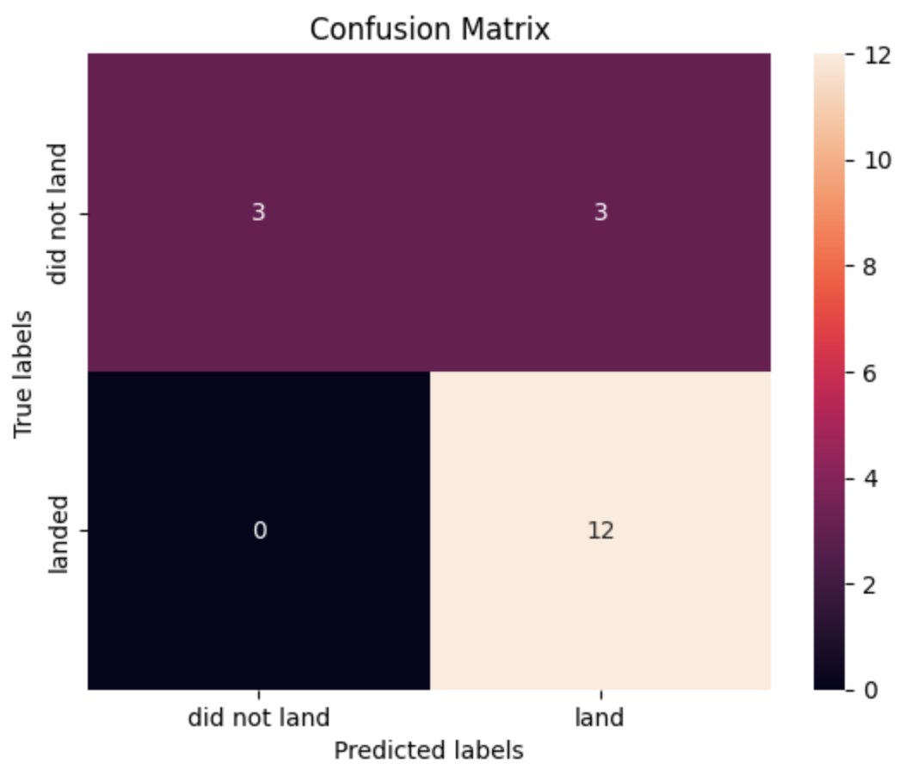
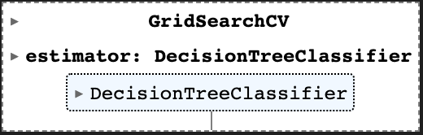
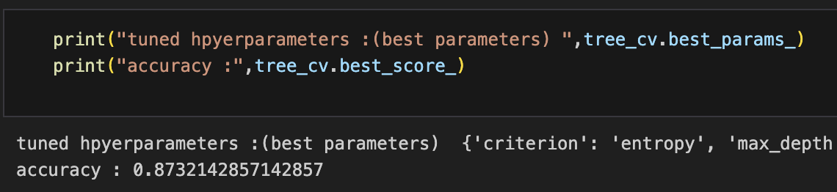
PREDICTIVE ANALYSIS RESULTS
Decision Tree Classifier
The image above shows the GridSearchCV for Decision Tree Classifier model and the accuracy on the test data using the method score is higher at 0.87. Also shown is the confusion matrix of the decision tree classifier model.
48

Slide 49
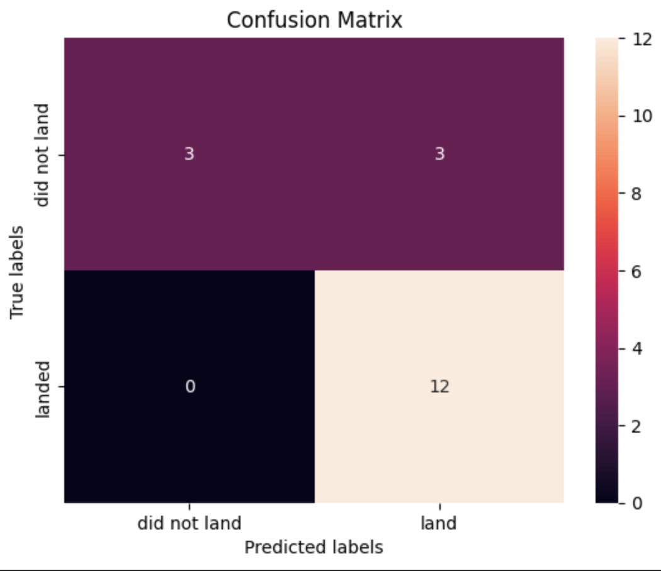
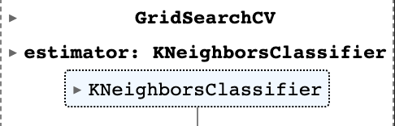
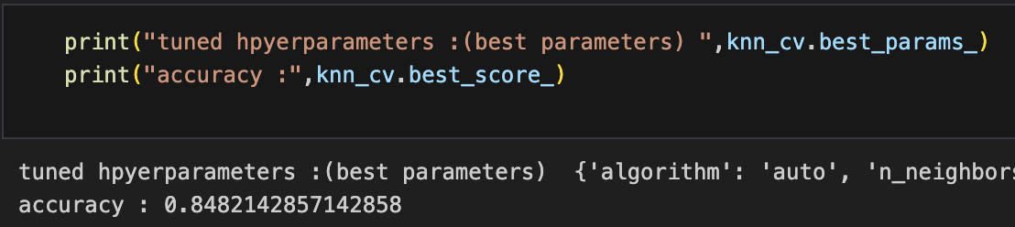
PREDICTIVE ANALYSIS RESULTS
K Nearest Neighbors
The image above shows the GridSearchCV for K Nearest Neighbors Classifier model and the accuracy on the test data using the method score is at 0.85. Also shown is the confusion matrix of the K nearest neighbors classifier model.
49

Slide 50
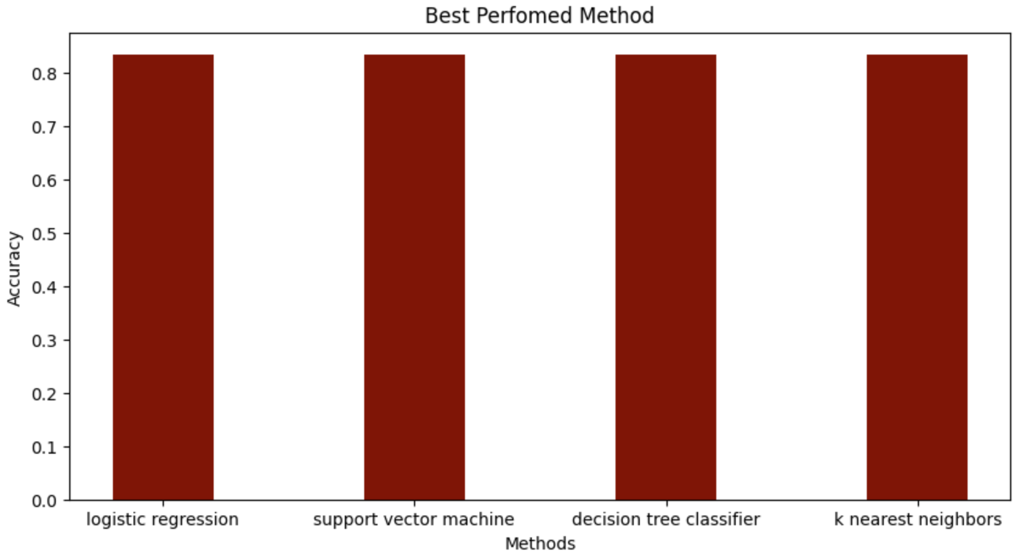
PREDICTIVE ANALYSIS RESULTS
Comparison of Models
As shown on the bar graph above comparing the models, all the four models performed almost with the same accuracy at roughly .83 to .87. The small sample size may have caused this nearly the same results between them.
50

Slide 51
Conclusion
Developing a machine learning model in order to predict the success of Stage 1 landing as it would save millions of dollars in order to compete in the Commercial Space Flight, SpaceY commissioned by founder Allon Mask, this study.
Through applied data science, collecting useful data from the SpaceX public API and webscraping public sources like the Wikipedia page, creating interactive visualizations including an interactive map and a dashboard, analyzing the data collected through exploratory data analysis and SQL queries, and creating machine models to predict the accuracy to determine successful launch.
It was concluded that further studies be made, with additional data that could be collected, the machine learning model would be able to predict more accurately the success.
51

Slide 52
Acknowledgement
I would like to acknowledge and thank all the Professors and Instructors that created the IBM Applied Data Science Course along with Coursera.org
I would also like to thank also my peers that have tirelessly contributed to the success of this course.
JUAN JUAN
https://github.com/j1-j1/AppliedDataScienceCapstone
January 15, 2024
52

